Slide 1
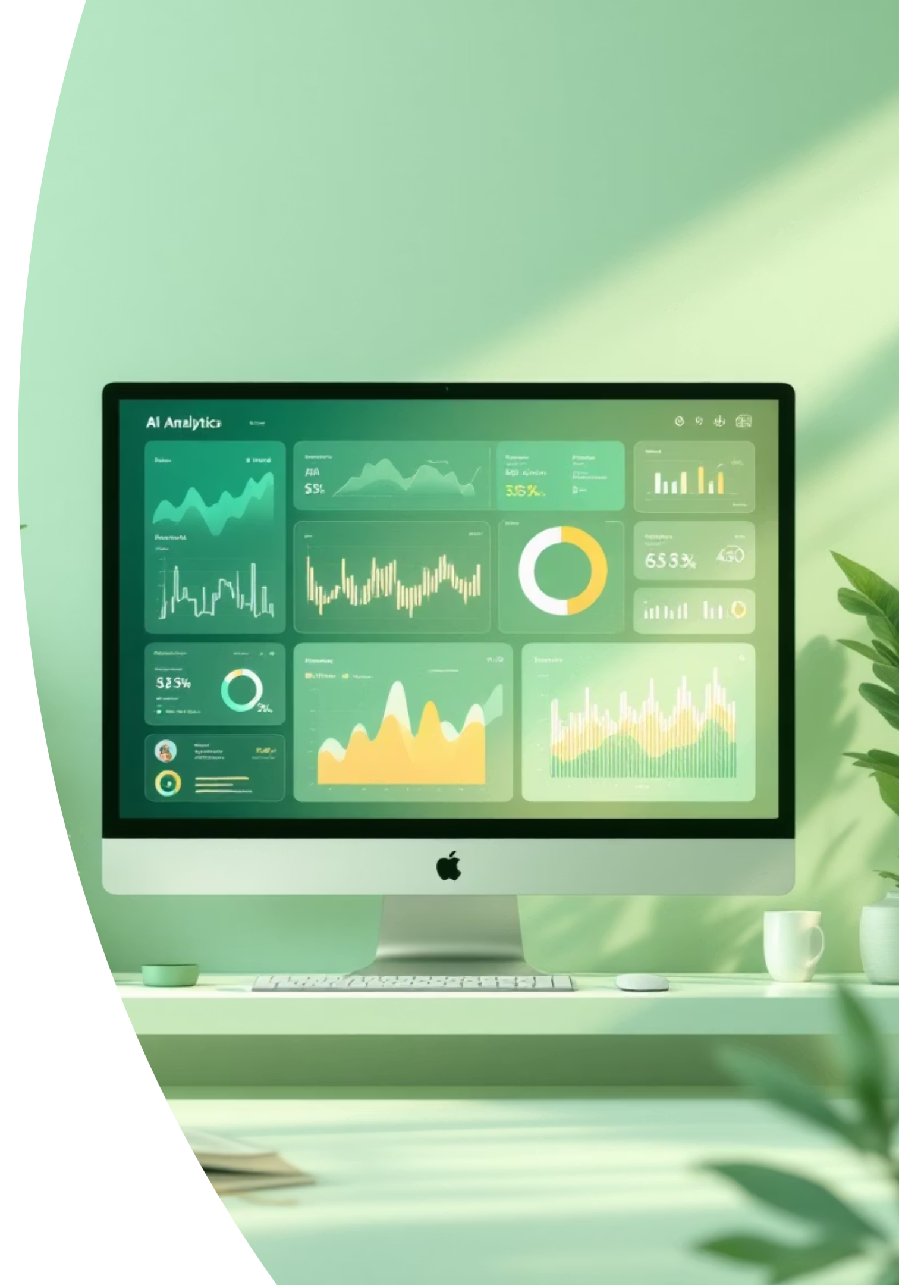
Personalized Healthcare Recommendation System
Using XGBoost + Flask Web App
Shaik Zakir Ahammad | Final Project

Slide 2

Problem Statement
Healthcare systems need early detection of patient risks.
Manual analysis of patient visit data is time-consuming.
Goal: Predict whether a patient is healthy or requires attention, and provide actionable recommendations.

Slide 3
Objectives
01
02
Preprocess and scale patient health data.
Handle class imbalance with SMOTE.
03
04
Train an XGBoost classifier for accurate predictions.
Deploy predictions in a Flask web application for real-time use.

Slide 4

Dataset Description
Target:
target → 0 = Healthy, 1 = Requires Attention
File: blood.csv
Size: 748 rows × 5 columns
Features:
Recency (days since last visit)
Frequency (number of visits)
Monetary (amount spent)
Time (relationship duration)

Slide 5
Methodology
Preprocessing:
Balancing:
StandardScaler applied to numeric features.
SMOTE used to handle imbalance (570 healthy vs. 178 at-risk).
Modeling:
Evaluation:
XGBoost Classifier with eval_metric='mlogloss'.
Accuracy, Precision, Recall, F1-score.

Slide 6
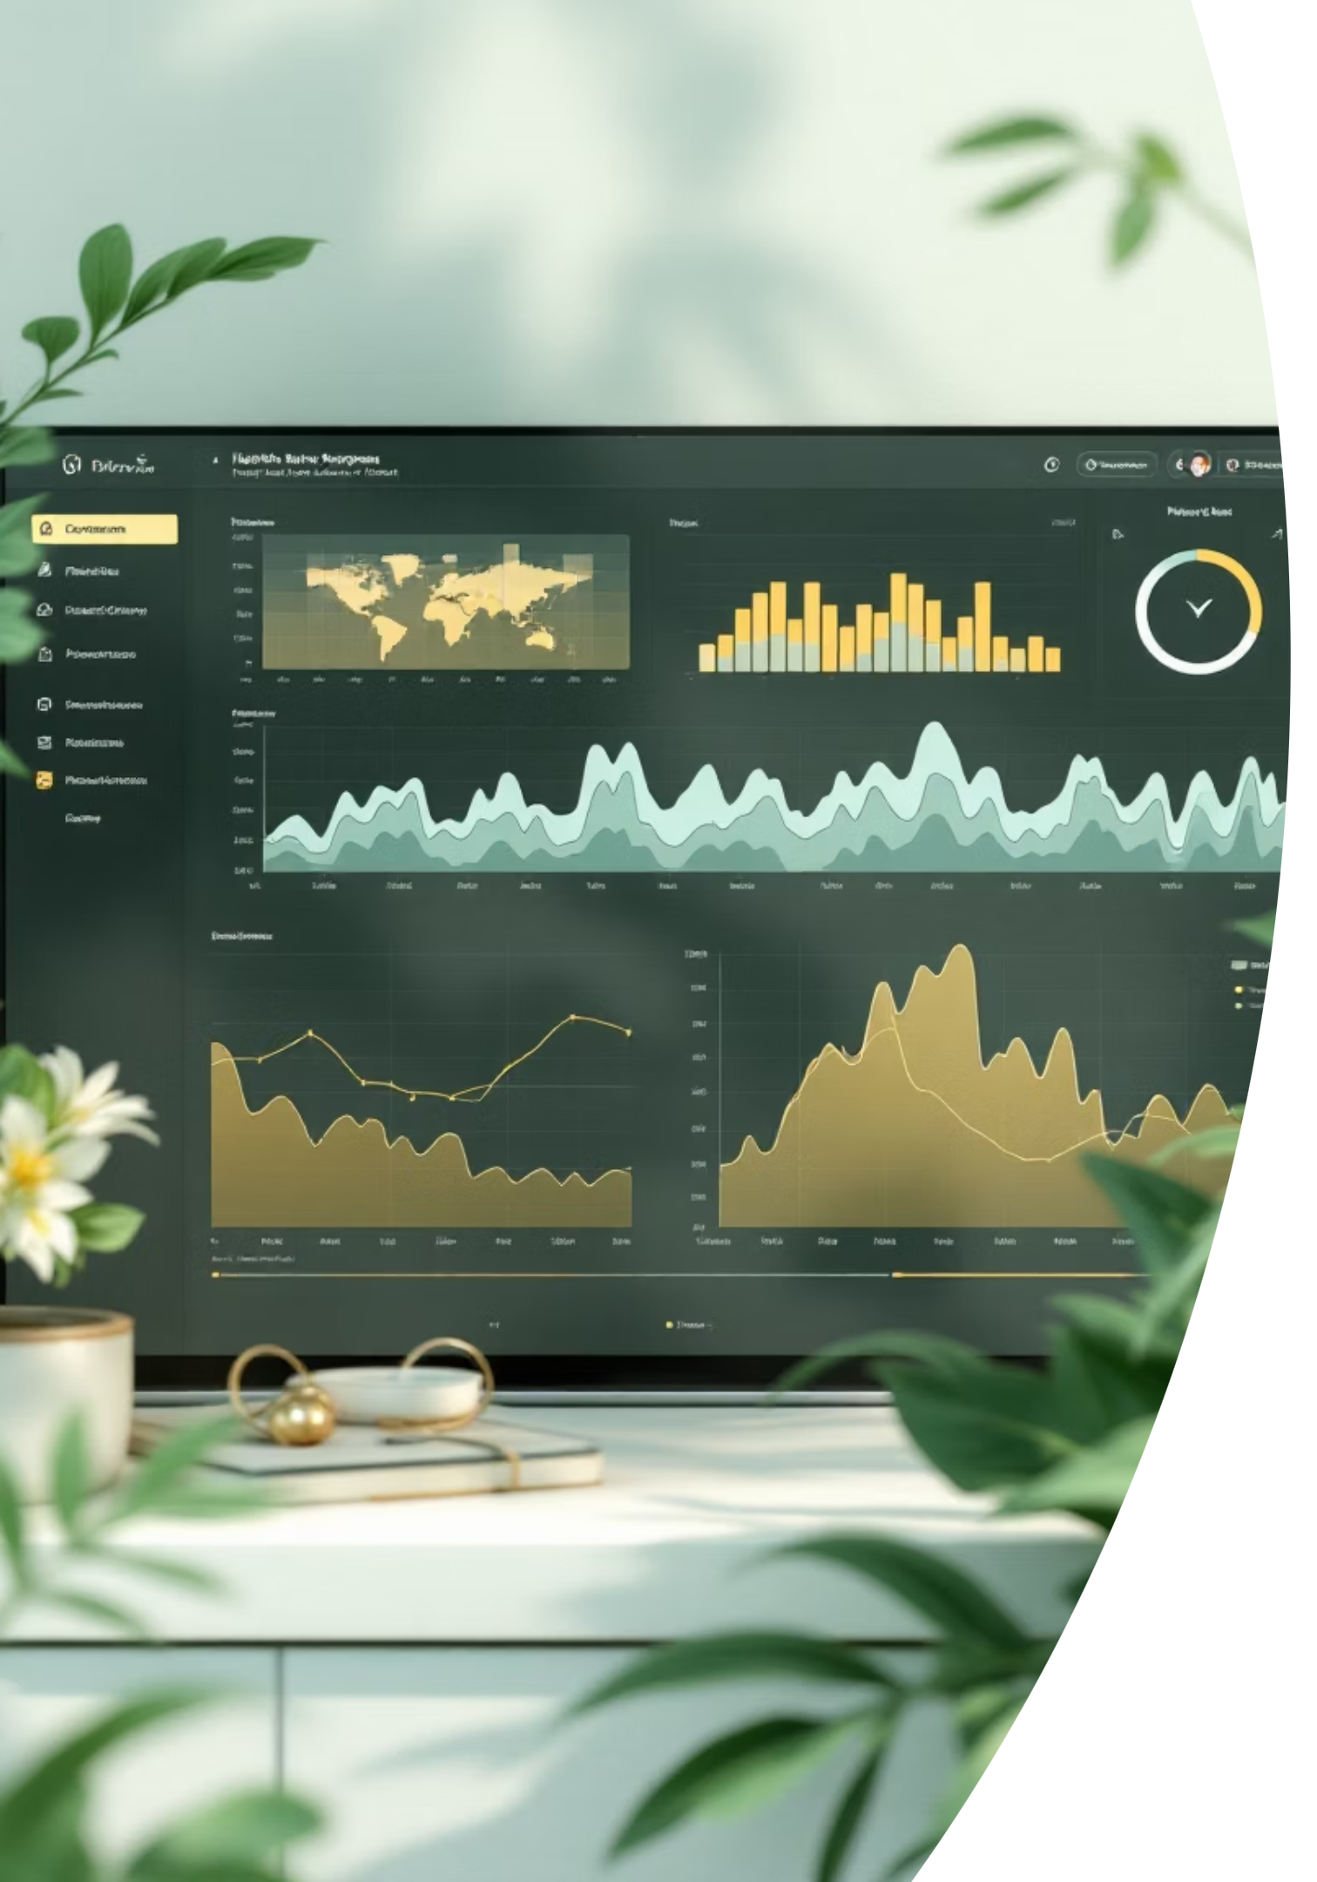

Exploratory Data Analysis
Distribution shows majority patients are in the healthy class (0).
After SMOTE, dataset is balanced for training.
Feature scaling ensures fair contribution from all variables.
Visualizations: histograms, correlation heatmaps.

Slide 7
Modeling Approach
Train/Test Split: 80/20.
Metrics:
XGBoost: strong classifier for imbalanced structured data.
0.76
0.75
Accuracy
Precision
0.76
0.755
Recall
F1-score

Slide 8
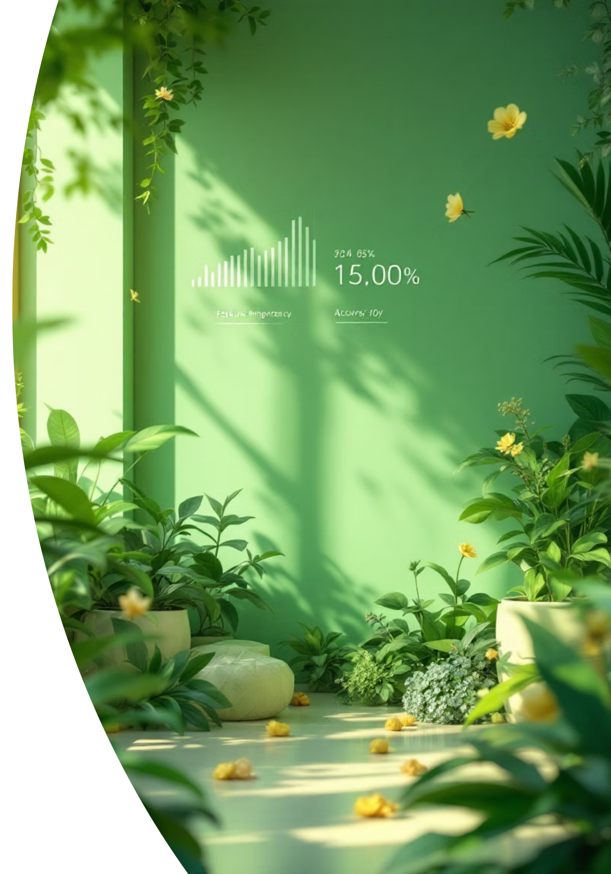
Results & Insights
SMOTE improved model fairness across classes.
XGBoost captured non-linear relationships well.
Feature importance highlights Recency and Frequency as key predictors.
Patients flagged "Requires Attention" can be targeted for preventive care.

Slide 9




Conclusion
Built a full pipeline: preprocessing → SMOTE → XGBoost → Flask app.
Achieved solid predictive performance (≈76% accuracy).
Provides personalized healthcare recommendations in real-time.
Helps medical staff focus on patients most at risk.

Slide 10
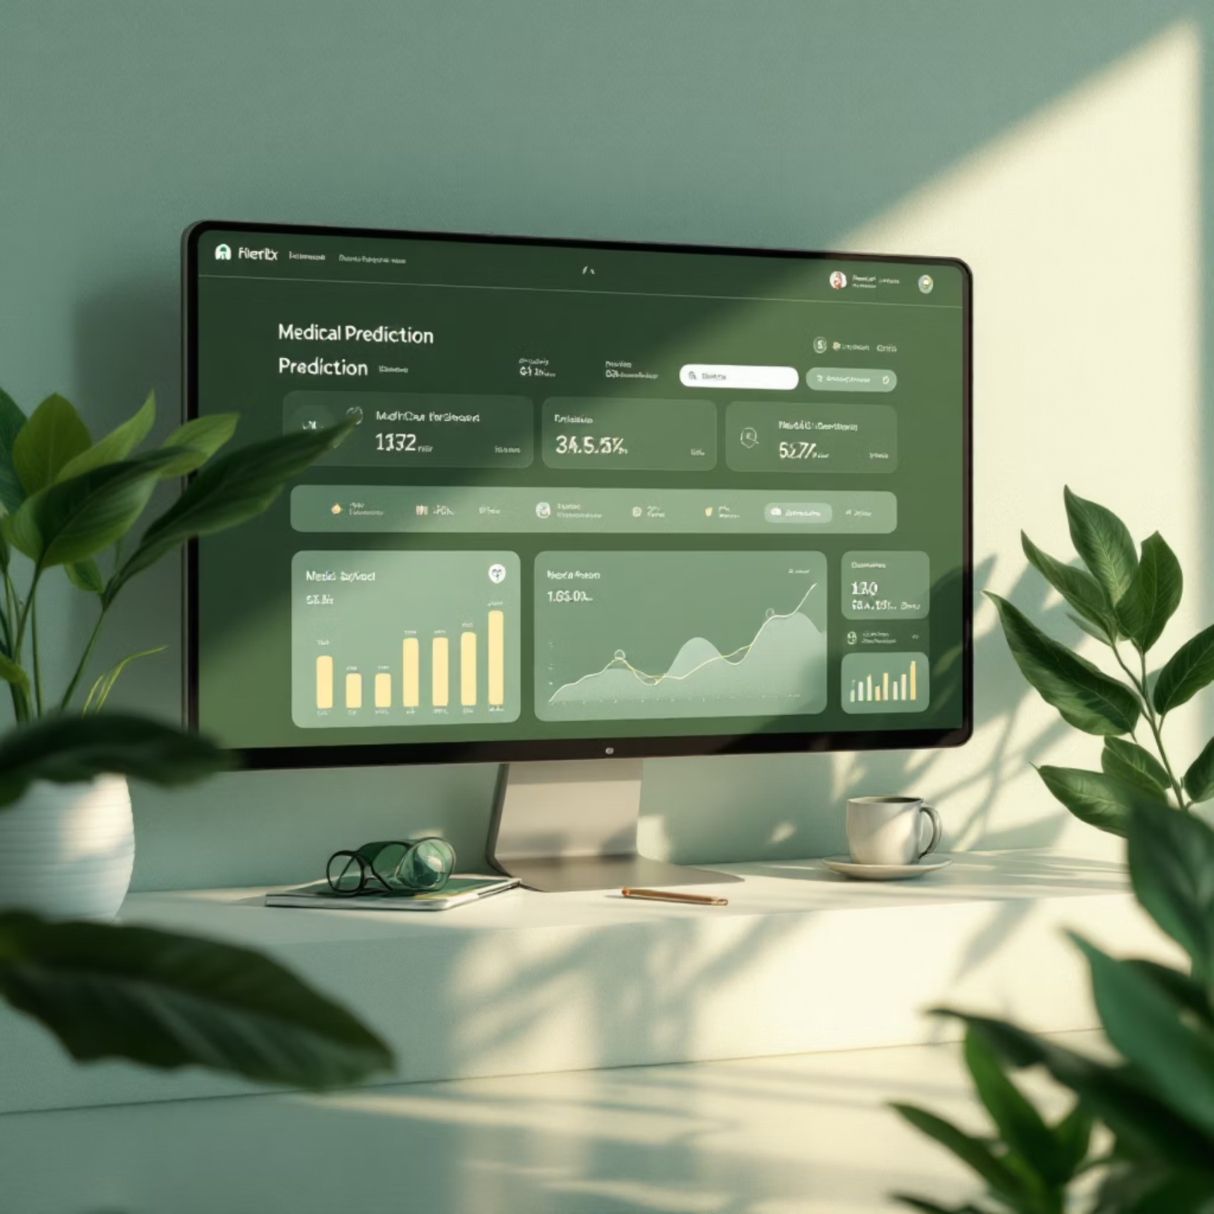
Future Work & References
References:
Flask Docs, XGBoost Docs, scikit-learn, imbalanced-learn.
Future Work:
Add SHAP explainability to interpret predictions.
Include more features (diet, fitness, lifestyle).
Deploy app on Render / Hugging Face / AWS.
Extend dataset with real clinical records.

